Slide 1
Computer Graphics
creation and manipulation of visual images using computers

Slide 2
Introduction to Computer Graphics
The creation, manipulation, and display of visual content on digital platforms.
Utilized across various industries to represent data visually, including science, engineering, medicine, entertainment, advertising, and education.

Slide 3
Applications of Computer Graphics
Design & Visualization:
CAD for architecture, product design, engineering.
Simulation and dynamic visualization enhance creativity.
Entertainment:
CGI in film and animation.
Realistic graphics in video games.
Medical & Scientific Visualization:
Diagnostic imaging and 3D modeling.
E-Learning:
Interactive and engaging educational content.

Slide 4
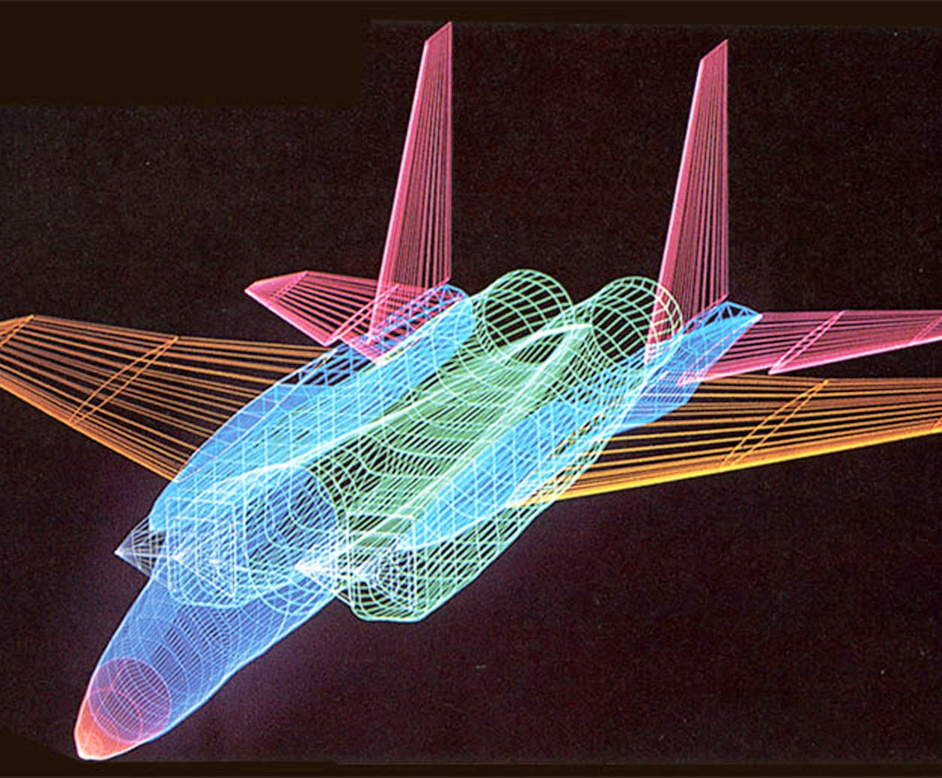
Pixels & Resolution
Pixel:
The smallest unit of a digital image displayed on a screen.
Resolution:
Image Resolution: Pixel density (PPI).
Screen Resolution: Total number of pixels in both dimensions.

Slide 5
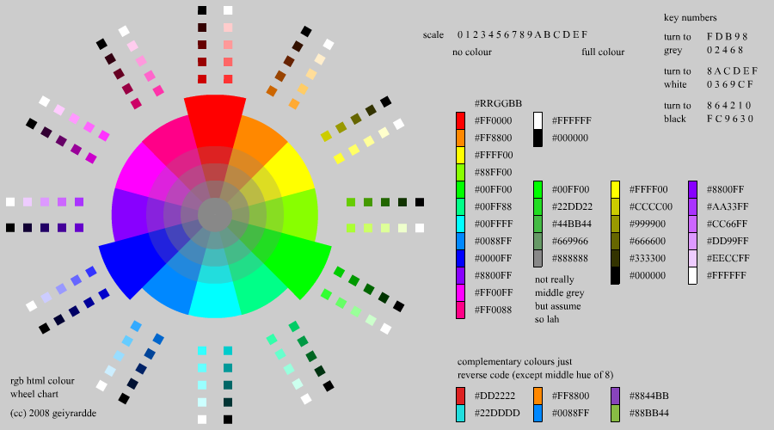
Color Depth & Bitplanes
Color Depth: The number of colors a pixel can
represent.
True Color: 24-bit (16.7 million colors).
High Color: 16-bit (65,536 colors).
256-Color Mode: 8-bit (256 colors).
Bitplanes:
Memory used to store pixel color intensity.
More bitplanes = better color detail.

